Slide 1
SQL ASSIGNMENTS
I have done this SQL assignment b connecting local server to jupyter notebook.

Slide 2

Connecting to jupyter notebook to local server

Slide 3

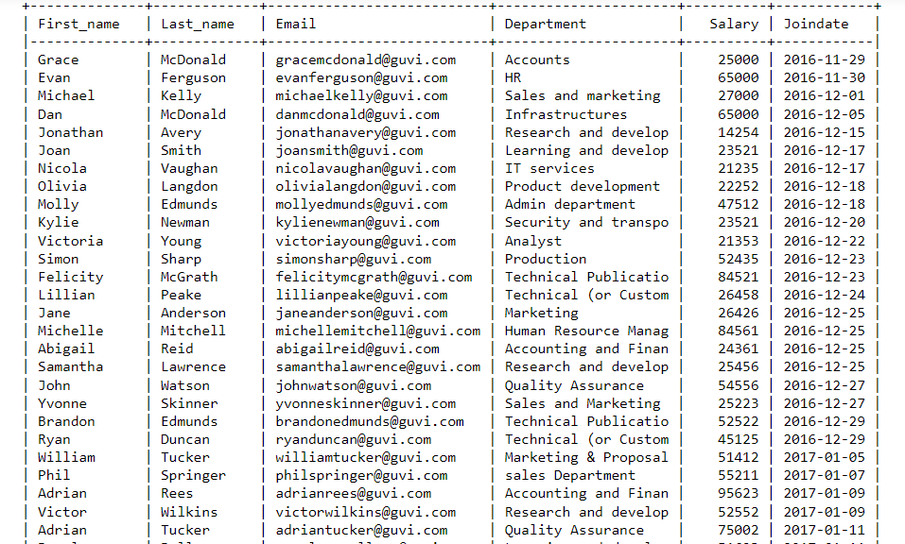
Table created

Slide 4
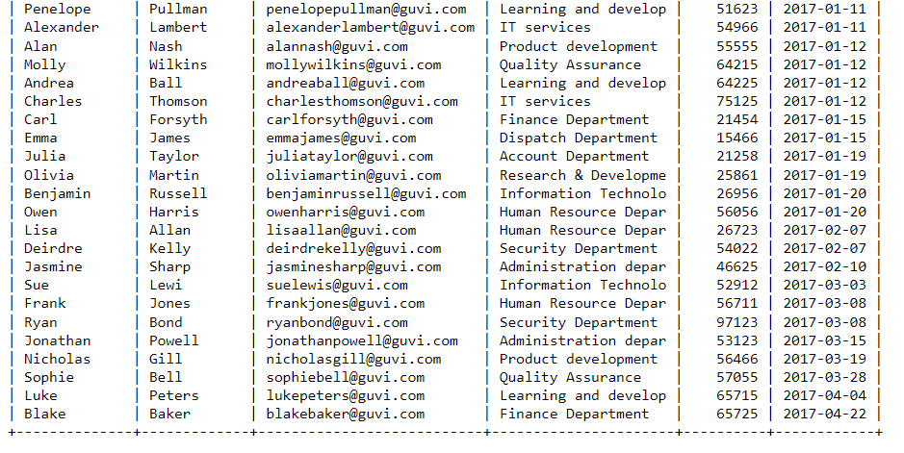
Table contd:

Slide 5
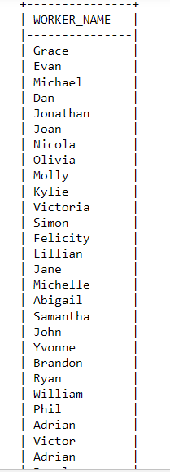
TASK1 -1

Slide 6

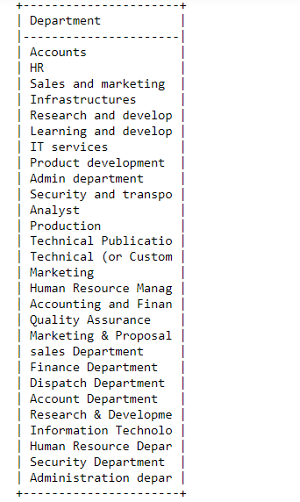
TASK1 -2

Slide 7

TASK1 -3

Slide 8
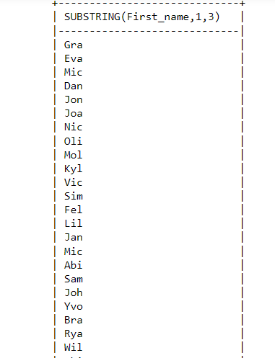
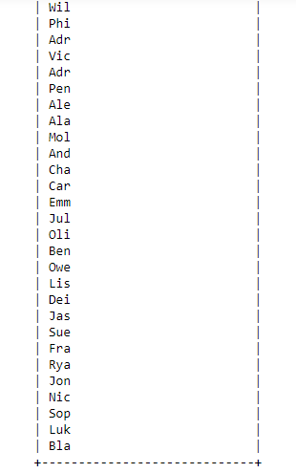
TASK 2 -1

Slide 9
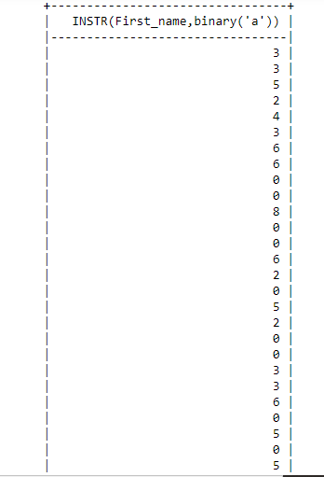
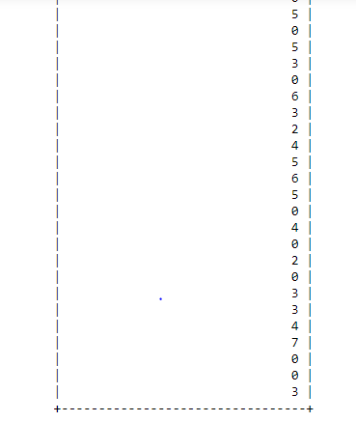
TASK 2 -2

Slide 10

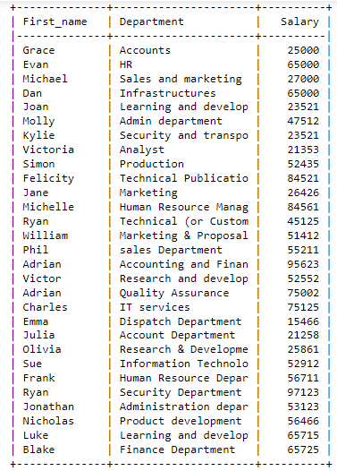
TASK 2 -3

Slide 11
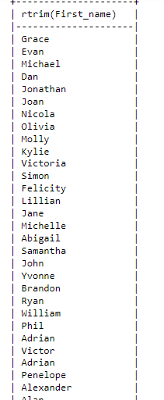
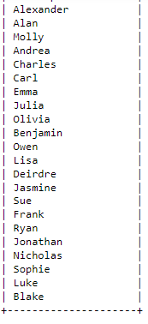
TASK 3 -1

Slide 12
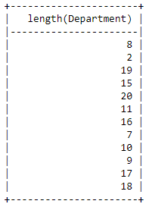
TASK 3 -2

Slide 13

TASK 3 -3

Slide 14
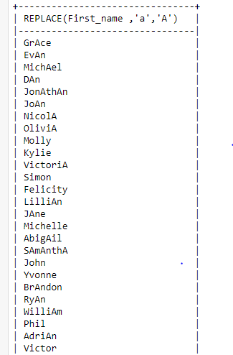
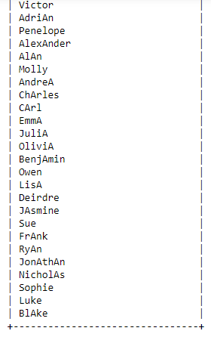
TASK 4-1

Slide 15
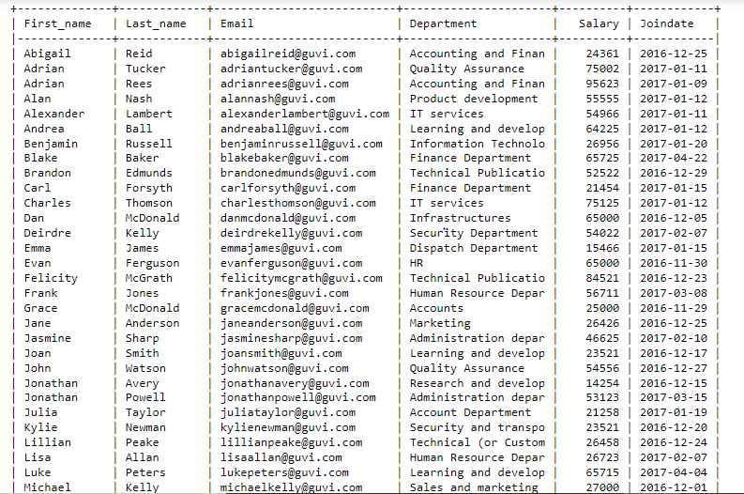
TASK 4-2

Slide 16
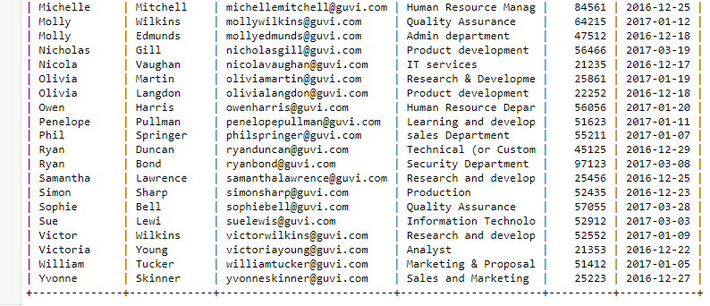
TASK 4-2

Slide 17

TASK 4-3

Slide 18


TASK 5-1
TABLE BEFORE THE QUERY
TABLE AFTER THE QUERY

Slide 19

TASK 5-2

Slide 20
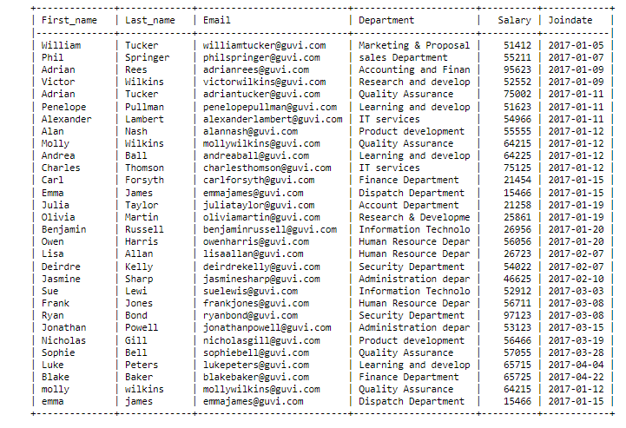
TASK 6-1

Slide 21
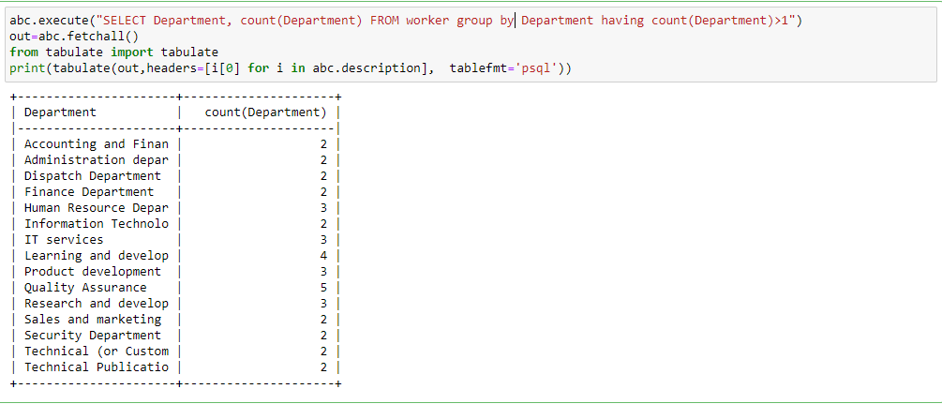

TASK 6-2
TASK 6-3

Slide 22
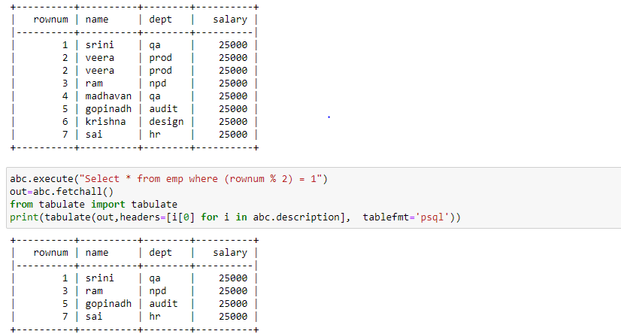
TASK 7-1

Slide 23
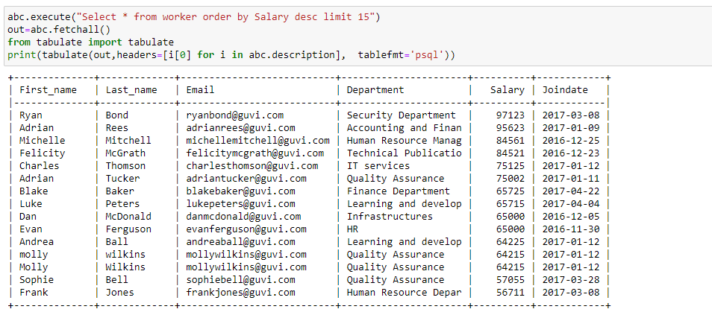

TASK 9-1
TASK 9-2

Slide 24

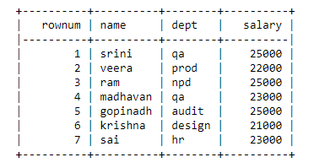

TASK 10-1
TASK 10-2

